Slide 1
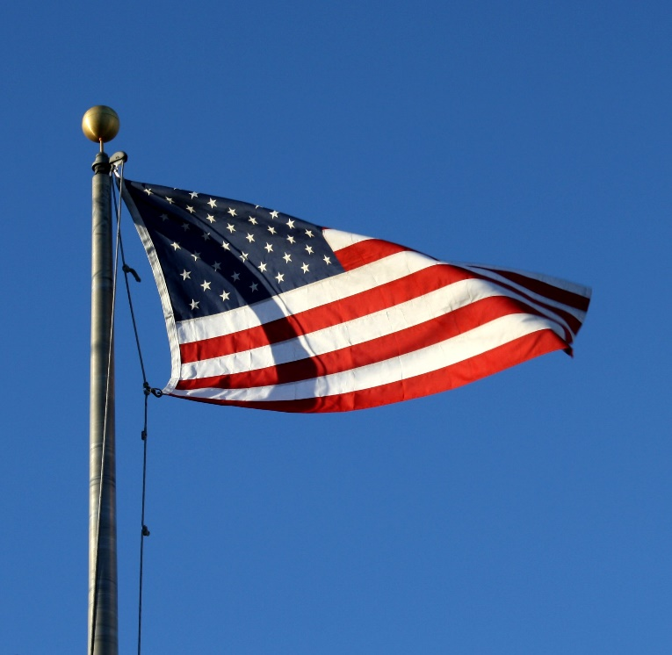
The Green Zone Goal:
To create awareness and education about military culture and service members trying to re-acclimate to civilian and college life
Serving those who have served us!
What is the Green Zone?
- An initiative to support student veterans by designating locations recognized as a “safe place”
- Identifies faculty and staff throughout TCSG who are knowledgeable about issues faced by student veterans/family member and the resources available to assist them.
- Participants are identified by a Green Zone emblem located outside their office door and/or on their syllabus
- A way to be supportive to those who have sacrificed for others
- Helps faculty and staff provide supportive services necessary to ensure that veteran students or veteran family member are successful in their academic pursuits, adjust to the campus environment, and eventually transition to civilian employment
The list of your Green Zone Team follows on the next pages.

Slide 2
Chattahoochee Technical College Green Zone Team
(A – B)
Serving those who have served us!
Name Campus Building Room Number
Akinsipe, Bernita Marietta C 1102 A
Apple, Michelle North Metro C 305T
Auensen, Don Marietta D 2211 (Library)
Austin, Miguelita Marietta C 1102H
Barthelemy-Morton, Gina North Metro F 235
Blalock, Christal Marietta F 1115
Boon, Malcolm North Metro Facilities and Maintenance
Bovell, Catherine North Metro A 132 (Student Affairs)
Bramlett, Lori Appalachian 308
Brooks, Keith Appalachian 413
Busse, R. Diane Busse Mountain View 233

Slide 3
Chattahoochee Technical College Green Zone Team
(C – H)
Serving those who have served us!
Name Campus Building Room Number
Cannon, Judy Marietta B 116.3
Canyon, Christine Marietta D 2216G
Carder, Samantha North Metro A Library
Carroll, Michael North Metro B 200J
D'Amour, Rockfield Marietta C 1102F
Darby, Jody North Metro A 104H
Easton-Long, Sheri Marietta F 2122
Faix, Nina Appalachian 229
Farries, Angelia Marietta H 1110
Foster, Leigh North Metro A 101A
Geis, Diane Marietta B 200L
Green, Courtney North Metro F 238B
Holland, Cynthia North Metro D 406
Huskic, Elsada Marietta Facilities and Maintenance

Slide 4
Chattahoochee Technical College Green Zone Team
(K – N)
Serving those who have served us!
Name Campus Building Room Number
Kemp-Carmichael, Leroysha Marietta G 1147
Kinton, Richard Canton Academic Affairs Instructor
Lawrence, Carolyn Canton 104B
Lyle, Amy Paulding A 122
Magee, Jackie North Metro G 101 - Adult Education
Marlowe Margaret Marietta G 1128
Mattox-Carroll, Cheri North Metro A 132N
McClung, Jil Paulding A 234
McWaters, Ron Mountain View Front Desk - Student Affairs
Miller, Deborah Paulding B 203
Munday, Barry Paulding A 207
Nelson, Richard (Rick) Marietta F 1133
Nutter, Fred North Metro Technical Support

Slide 5
Chattahoochee Technical College Green Zone Team
(O - Z)
Serving those who have served us!
Name Campus Building Room Number
O'Rear, Mike North Metro B Academic Affairs Instructor
Petty, E. Diane Canton 104F
Porter, Robert North Metro G Adult Education
Ranney, Krystal Appalachian 110
Reisen, Angela Marietta G 1107
Shirley, Alycia Appalachian 227 - Library
Smith, Alyssa Marietta A 1125
Southern, Monica Paulding A 211
Torres, Eilla Marietta G 1134
Wallace, Alexis Marietta G Front Counter - Financial Aid
Ward, Amy North Metro B 305H
Weeks, Cathy North Metro A 132M
Weinman , Robin Canton 100
White, Kayla Marietta D 2216A
Womack, Linda North Metro A 132S

